Slide 1
Arrays and Sorting
Christopher Mar

Slide 2
Array
Data structure
Array name is a pointer
Memory address of first element
Other elements accessed using offset (number of elements from first element)

Slide 3
Array Data Access
Address | Contents
0x10000000 | 12
0x10000004 | 256
0x10000008 | 9
0x1000000C | 37
0x10000010 | 654
0x10000014 | 81
0x10000018 | 0
0x1000001C | 5309
lw
register
sw
register

Slide 4
Traversing an Array
Loop that increments offset
my_array[i]
Counter, i, is the offset from the base address

Slide 5
Traversing an Array
Problem: in PLP offset is a fixed value
Architectural choice limits lw/sw to 2 register accesses
Solution: save base address (if needed) and increment register pointing to array address

Slide 6
Traversing an Array
Final Project:
Values in array are 32-bit unsigned integers
1 word (4 byte) offset per element

Slide 7
Value Comparison (Inequality)
slt $rd, $rs, $rt
If $rs < $rt then $rd set to 1 (true)
Else $rd set to 0 (false)
Result often used in a branch (compared with zero register)
bne $rd, $0, was_less_than

Slide 8
Inequalities
Inequality | Instruction | R if inequality is true
A < B | slt R, A, B | 1
A >= B | slt R, A, B | 0
A > B | slt R, B, A | 1
A <= B | slt R, B, A | 0

Slide 9
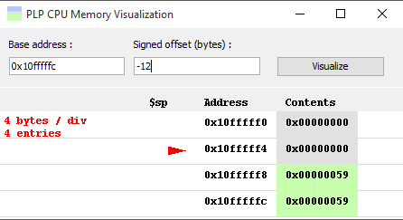
PLPTool Memory Visulizer
Notes:
Discussed in lecture 5

Slide 10
PLPTool Memory Visulizer
Accessible while in simulation mode
Simulation → Tools → Create a PLP CPU Memory Visualizer

Slide 11
Thanks for Watching

